Slide 1
CONTENTS
Systems of Linear Algebraic Equations
b. LU Decomposition

Slide 2
Systems of Linear Algebraic Equations
b) LU Decomposition
There are many methods developed in Matrix computation. The LU decomposition of the Gaussian elimination technique, however, is the most practical of these techniques. One reason for initiating LU decomposition is that it provides an effective means of calculating the inverse of The Matrix. It is possible to show that any square matrix A can be expressed as a product of a lower triangular matrix L and an upper triangular matrix U:
A = LU
The process of computing L and U for a given A is known as LU decomposition or LU factorization. LU decomposition methods separate the time-consuming elimination of the matrix [A] from the manipulations of the right-hand side {B}. Thus, once [A] has been “decomposed,” multiple right-hand-side vectors can be evaluated in an efficient manner. Unless certain constraints are placed on L or U, these constraints distinguish one type of decomposition from another.

Slide 3
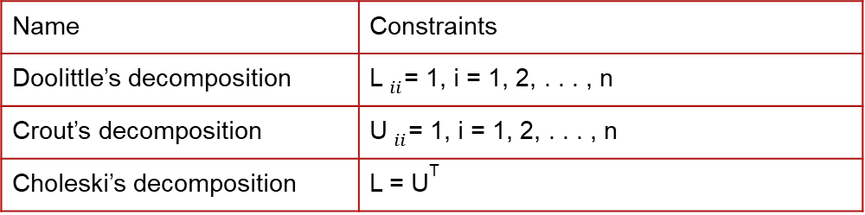
Three commonly used decompositions are listed in;
After decomposing A, it is easy to solve the equations Ax = b. We first rewrite the equations as LUx = b. After using the notation Ux = y, the equations become;
L y = b
which can be solved for y by forward substitution. Then
U x = y
will yield x by the back substitution process.
The advantage of LU decomposition over the Gauss elimination method is that once A is decomposed, we can solve Ax = b for as many constant vectors b as we please. The cost of each additional solution is relatively small, because the forward and back substitution operations are much less time consuming than the decomposition process.
Name | Constraints
Doolittle’s decomposition | L$_{ii}$= 1, i = 1, 2, . . . , n
Crout’s decomposition | U$_{ii}$= 1, i = 1, 2, . . . , n
Choleski’s decomposition | L = U^{T}

Slide 4
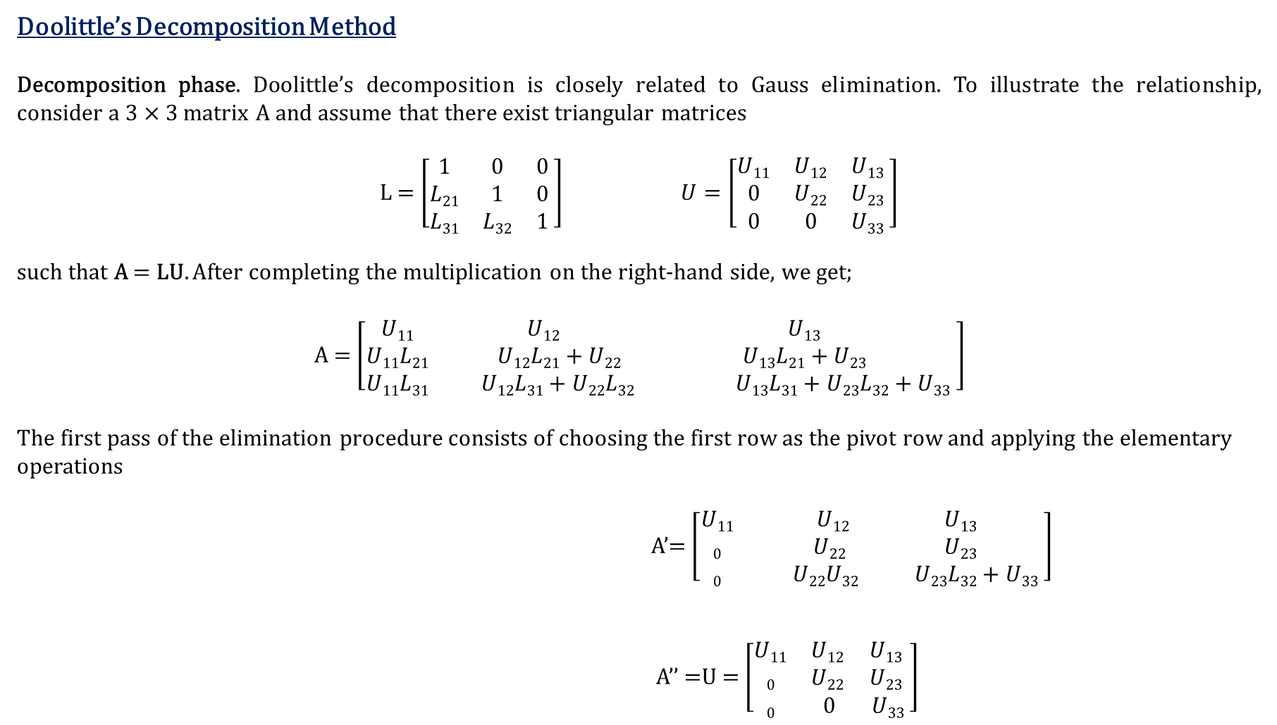
Doolittle’s Decomposition Method
Decomposition phase. Doolittle’s decomposition is closely related to Gauss elimination. To illustrate the relationship, consider a 3 × 3 matrix A and assume that there exist triangular matrices
L = $\left[\begin{matrix}1 & 0 & 0 \\ L21 & 1 & 0 \\ L31 & L32 & 1\end{matrix} \right] U=\left[\begin{matrix}U11 & U12 & U13 \\ 0 & U22 & U23 \\ 0 & 0 & U33\end{matrix} \right]$
such that A = LU. After completing the multiplication on the right-hand side, we get;
A = $\left[\begin{matrix}U11 & U12 & U13 \\ U11L21 & U12L21+U22 & U13L21+U23 \\ U11L31 & U12L31+U22L32 & U13L31+U23L32+U33\end{matrix} \right]$
The first pass of the elimination procedure consists of choosing the first row as the pivot row and applying the elementary operations
A’= $\left[\begin{matrix}U11 & U12 & U13 \\ 0 & U22 & U23 \\ 0 & U22U32 & U23L32+U33\end{matrix} \right]$
A’’ =U = $\left[\begin{matrix}U11 & U12 & U13 \\ 0 & U22 & U23 \\ 0 & 0 & U33\end{matrix} \right]$
row 2 ← row 2 − L₂₁ × row 1 (eliminatesA₂₁)
row 3 ← row 3 − L₃₁ × row 1 (eliminatesA₃₁)
row 3 ← row 3 − L₃₂ × row 2 (eliminatesA₃₂)

Slide 5
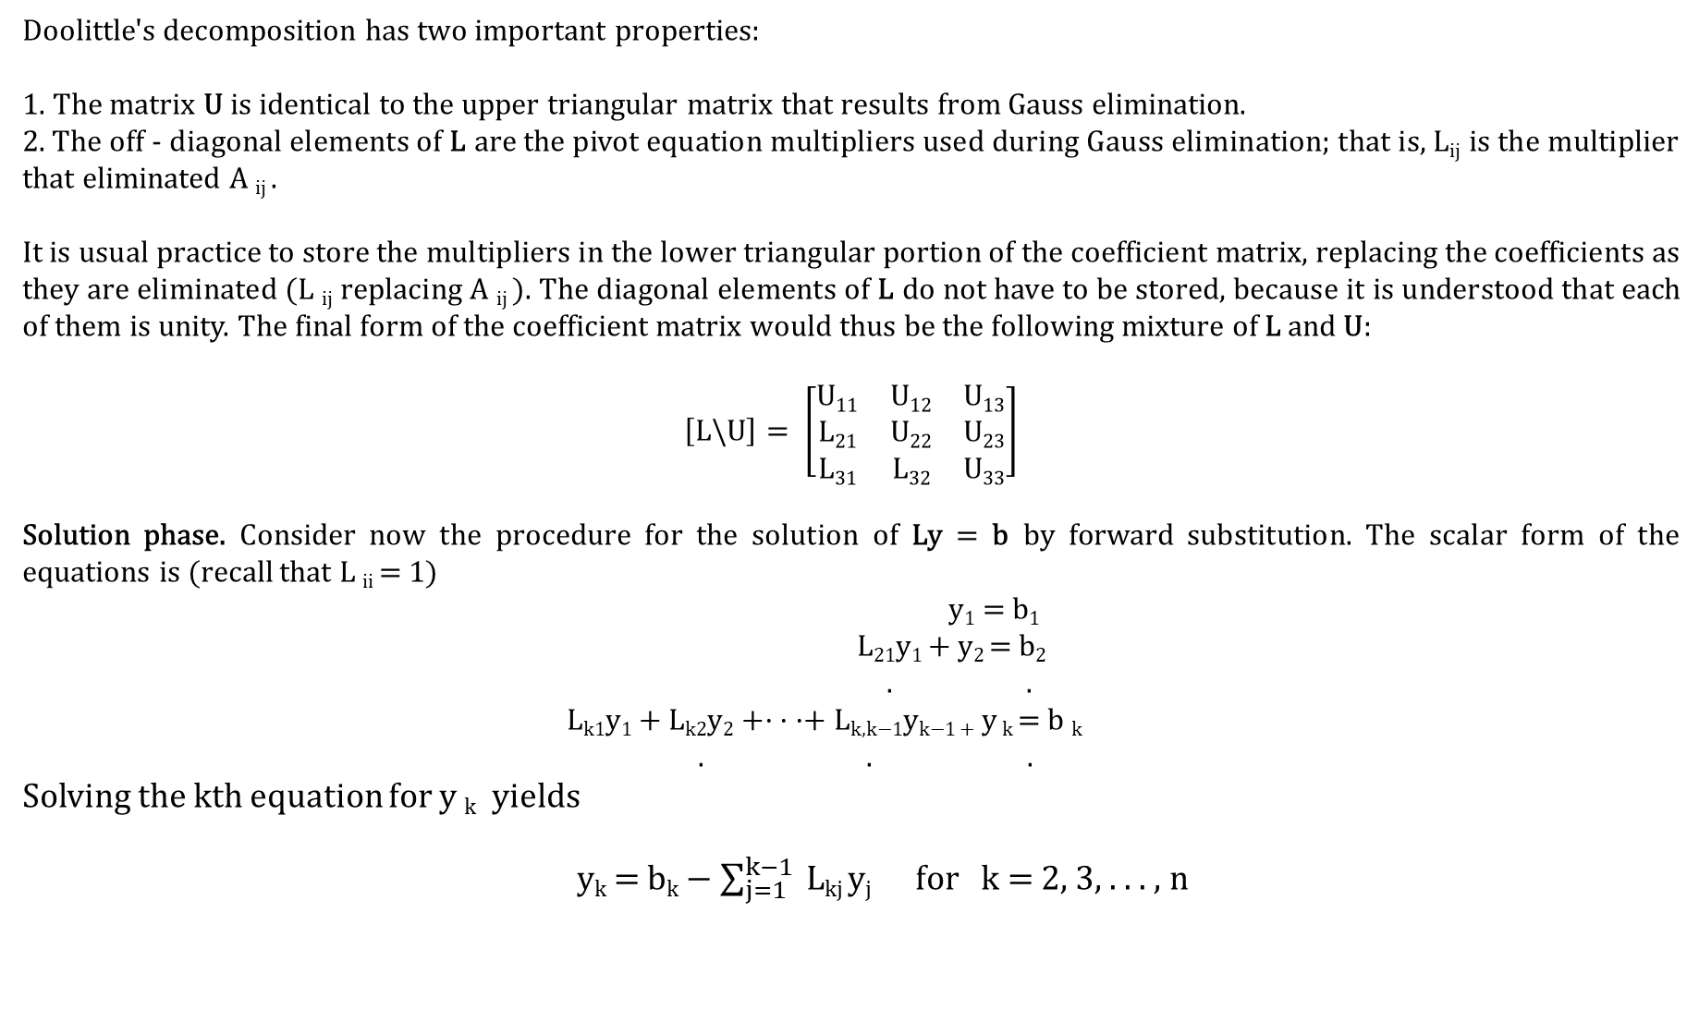
Doolittle's decomposition has two important properties:
1. The matrix U is identical to the upper triangular matrix that results from Gauss elimination.
2. The off - diagonal elements of L are the pivot equation multipliers used during Gauss elimination; that is, L_{ij} is the multiplier that eliminated A _{ij} .
It is usual practice to store the multipliers in the lower triangular portion of the coefficient matrix, replacing the coefficients as they are eliminated (L _{ij} replacing A _{ij} ). The diagonal elements of L do not have to be stored, because it is understood that each of them is unity. The final form of the coefficient matrix would thus be the following mixture of L and U:
$$\left[L\backslash U\right]= \left[\begin{matrix}U11 & U12 & U13 \\ L21 & U22 & U23 \\ L31 & L32 & U33\end{matrix}\right]$$
Solution phase. Consider now the procedure for the solution of Ly = b by forward substitution. The scalar form of the equations is (recall that L _{ii} = 1)
y₁ = b₁
L₂₁y₁ + y₂ = b₂
. .
L_{k1}y₁ + L_{k2}y₂ +· · ·+ L_{k,k−1}y_{k−1 +} y _{k} = b _{k}
. . .
Solving the kth equation for y _{k} yields
y_{k} = b_{k} − $\sum_{j=1}^{k−1}{ }$L_{kj} y_{j} for k = 2, 3, . . . , n

Slide 6

Example: Solve the system of equations with Doolittle’s Decomposition Method
1. Create matrices A, X and B , where A is the augmented matrix, X constitutes the variable vectors and B are the constants
2. Let A = LU, where L is the lower triangular matrix and U is the upper triangular matrix assume that the diagonal entries L is equal to 1
3. Let Ly = B, solve for y’s
4. Let Ux = y, solve for the variable vectors x
x₁ + x₂ + x₃ =5
x₁ + 2x₂ + 2x₃ =6
x₁ + 2x₂ + 3x₃ =8
Solution:
A=$\left(\begin{matrix}1 & 1 & 1 \\ 1 & 2 & 2 \\ 1 & 2 & 3\end{matrix}\right)$ X=$\left(\begin{matrix}x1 \\ x2 \\ x3\end{matrix}\right)$ B=$\left(\begin{matrix}5 \\ 6 \\ 8\end{matrix}\right)$
A=LU $\left(\begin{matrix}1 & 1 & 1 \\ 1 & 2 & 2 \\ 1 & 2 & 3\end{matrix}\right)$=$\left(\begin{matrix}1 & 0 & 0 \\ a & 1 & 0 \\ b & c & 1\end{matrix}\right)$. $\left(\begin{matrix}d & e & f \\ 0 & g & h \\ 0 & 0 & i\end{matrix}\right)$ $\left(\begin{matrix}1 & 1 & 1 \\ 1 & 2 & 2 \\ 1 & 2 & 3\end{matrix}\right)=\left(\begin{matrix}d & e & f \\ ad & ae+g & af+h \\ bd & be+cg & bf+ch+i\end{matrix}\right)$
d=1 e=1 f=1
ad=1 ag+g=2 af+h=2
a=1 g=1 h=1
bd=1 be+cg=2 bf+ch+i= 3
b=1 c=1 i=1

Slide 7

Ly=B $\left(\begin{matrix}1 & 0 & 0 \\ 1 & 1 & 0 \\ 1 & 1 & 1\end{matrix}\right).\left(\begin{matrix}Y1 \\ Y2 \\ Y3\end{matrix}\right)$=$\left(\begin{matrix}5 \\ 6 \\ 8\end{matrix}\right)$
y₁=5
y₁+y₂=6 y₂=1
y₁+y₂+y₃=8 y₃=2
y₁=5 y₂=1 y₃=2
Ux=y $\left(\begin{matrix}1 & 1 & 1 \\ 0 & 1 & 1 \\ 0 & 0 & 1\end{matrix}\right).\left(\begin{matrix}x1 \\ x2 \\ x3\end{matrix}\right)$=$\left(\begin{matrix}5 \\ 1 \\ 2\end{matrix}\right)$
x₃=2
x₂+x₃=1 x₂=-1
x₁+x₂+x₃=5 x₁=4
X=$\left(\begin{matrix} 4 \\ −1 \\ 2\end{matrix}\right)$

Slide 8
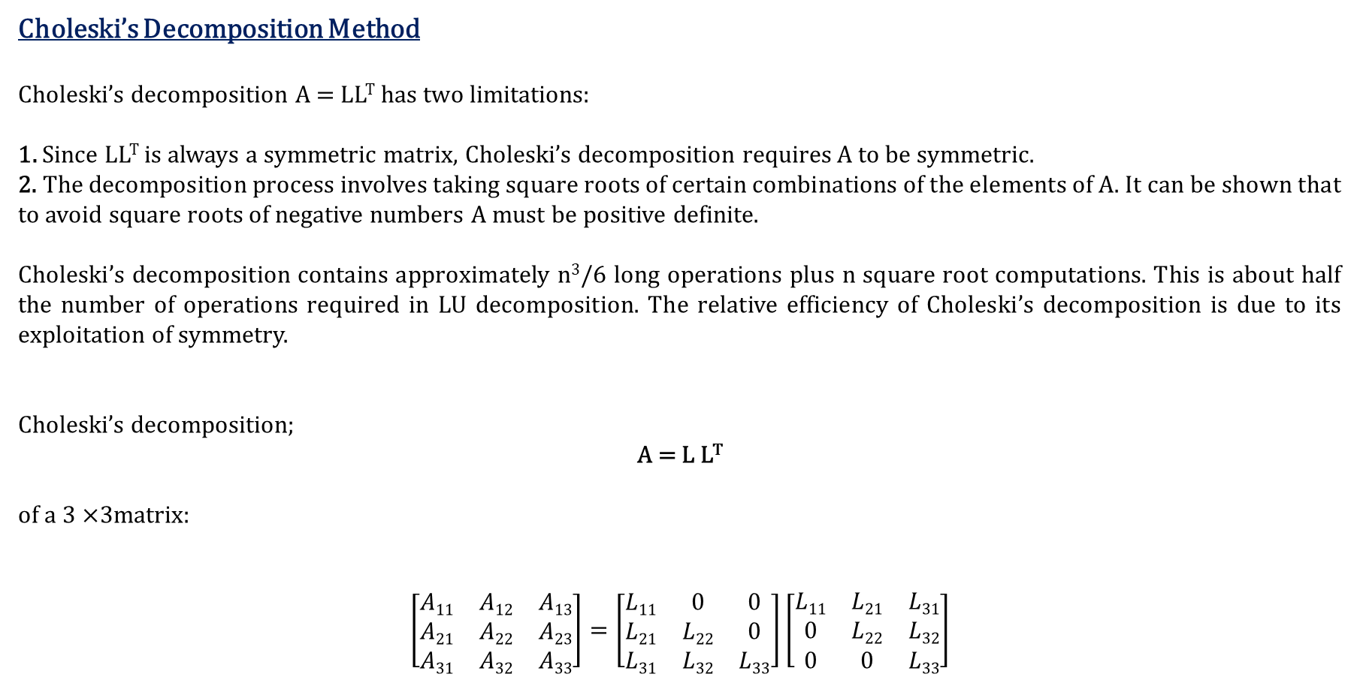
Choleski’s Decomposition Method
Choleski’s decomposition A = LL^{T} has two limitations:
1. Since LL^{T} is always a symmetric matrix, Choleski’s decomposition requires A to be symmetric.
2. The decomposition process involves taking square roots of certain combinations of the elements of A. It can be shown that to avoid square roots of negative numbers A must be positive definite.
Choleski’s decomposition contains approximately n³/6 long operations plus n square root computations. This is about half the number of operations required in LU decomposition. The relative efficiency of Choleski’s decomposition is due to its exploitation of symmetry.
Choleski’s decomposition;
A = L L^{T}
of a 3 ×3matrix:
$$\left[\begin{matrix}A11 & A12 & A13 \\ A21 & A22 & A23 \\ A31 & A32 & A33\end{matrix}\right]=\left[\begin{matrix}L11 & 0 & 0 \\ L21 & L22 & 0 \\ L31 & L32 & L33\end{matrix}\right]\left[\begin{matrix}L11 & L21 & L31 \\ 0 & L22 & L32 \\ 0 & 0 & L33\end{matrix}\right]$$

Slide 9
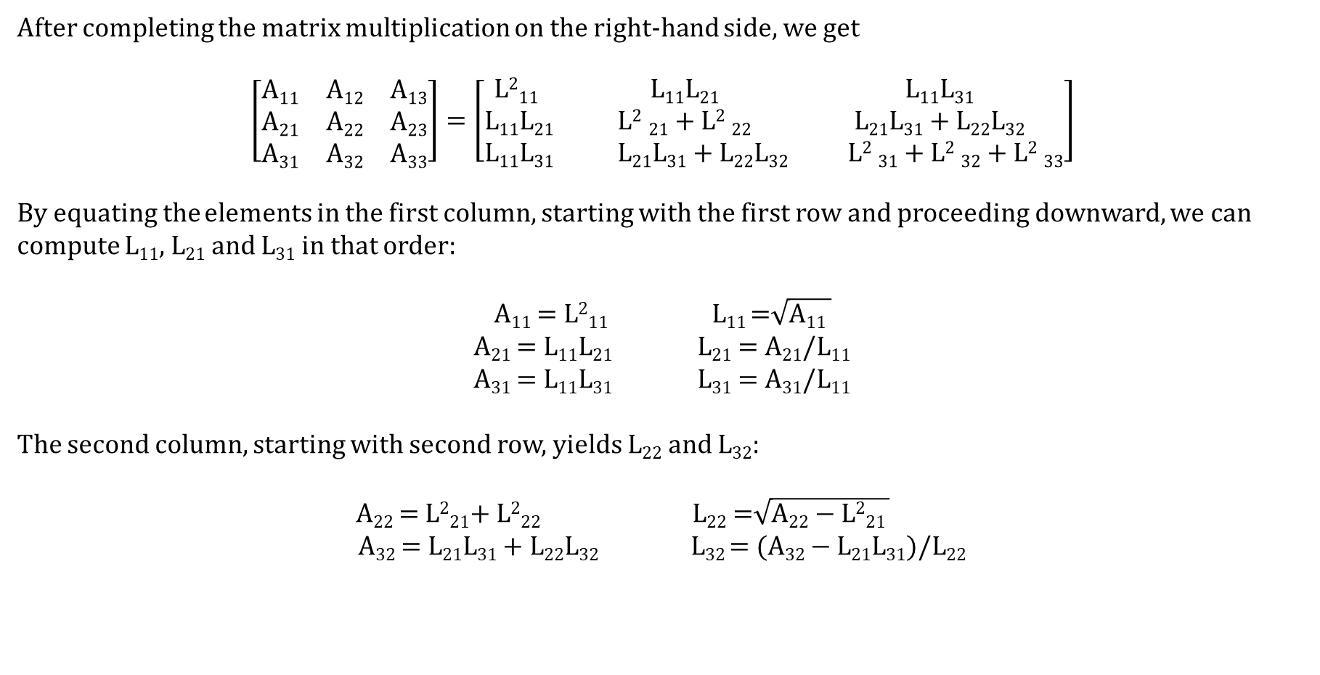
After completing the matrix multiplication on the right-hand side, we get
$$\left[\begin{matrix}A11 & A12 & A13 \\ A21 & A22 & A23 \\ A31 & A32 & A33\end{matrix}\right]=\left[\begin{matrix}\text{L}\text{2}\text{11} & \text{L}\text{11}\text{L}\text{21} & \text{L}\text{11}\text{L}\text{31} \\ \text{L}\text{11}\text{L}\text{21} & \text{L}\text{2} \text{21}\text{ + }\text{L}\text{2} \text{22} & \text{L}\text{21}\text{L}\text{31}\text{ + }\text{L}\text{22}\text{L}\text{32} \\ \text{L}\text{11}\text{L}\text{31} & \text{L}\text{21}\text{L}\text{31}\text{ + }\text{L}\text{22}\text{L}\text{32} & \text{L}\text{2} \text{31}\text{ + }\text{L}\text{2} \text{32}\text{ + }\text{L}\text{2} \text{33}\end{matrix}\right]$$
By equating the elements in the first column, starting with the first row and proceeding downward, we can compute L₁₁, L₂₁ and L₃₁ in that order:
A₁₁ = L²₁₁ L₁₁ =$\sqrt{\text{A}\text{11} }$
A₂₁ = L₁₁L₂₁ L₂₁ = A₂₁/L₁₁
A₃₁ = L₁₁L₃₁ L₃₁ = A₃₁/L₁₁
The second column, starting with second row, yields L₂₂ and L₃₂:
A₂₂ = L²₂₁+ L²₂₂ L₂₂ =$\sqrt{\text{A}\text{22}\text{ − }\text{L}\text{2}\text{21 }}$
A₃₂ = L₂₁L₃₁ + L₂₂L₃₂ L₃₂ = (A₃₂ − L₂₁L₃₁)/L₂₂

Slide 10
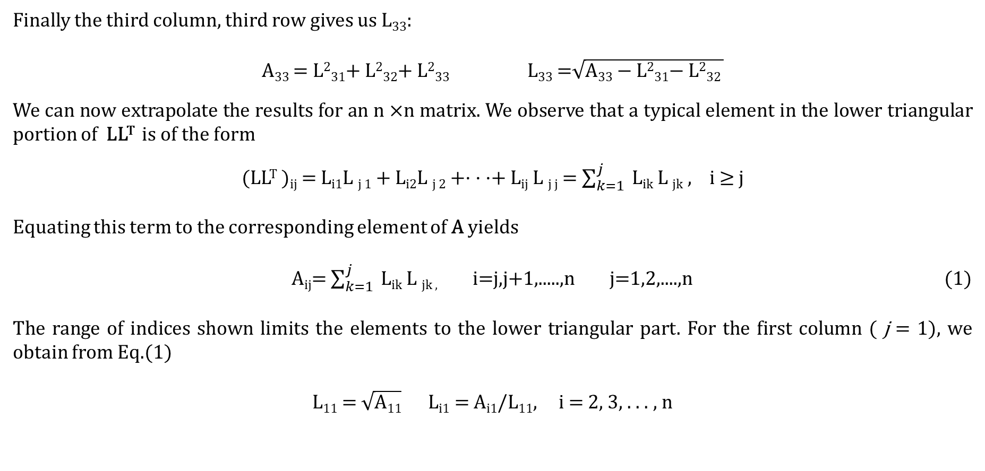
Finally the third column, third row gives us L₃₃:
A₃₃ = L²₃₁+ L²₃₂+ L²₃₃ L₃₃ =$\sqrt{\text{A}\text{33}\text{ − }\text{L}\text{2}\text{31}\text{− }\text{L}\text{2}\text{32 }}$
We can now extrapolate the results for an n ×n matrix. We observe that a typical element in the lower triangular portion of LL^{T} is of the form
(LL^{T} )_{ij} = L_{i1}L _{j 1} + L_{i2}L _{j 2} +· · ·+ L_{ij} L _{j j} = $\sum_{k=1}^{j}{ }$L_{ik} L _{jk} , i ≥ j
Equating this term to the corresponding element of A yields
A_{ij}= $\sum_{k=1}^{j}{ }$L_{ik} L _{jk ,} i=j,j+1,.....,n j=1,2,....,n (1)
The range of indices shown limits the elements to the lower triangular part. For the first column ( j = 1), we obtain from Eq.(1)
L₁₁ = $\sqrt{\text{A}\text{11}}$ L_{i1} = A_{i1}/L₁₁, i = 2, 3, . . . , n

Slide 11
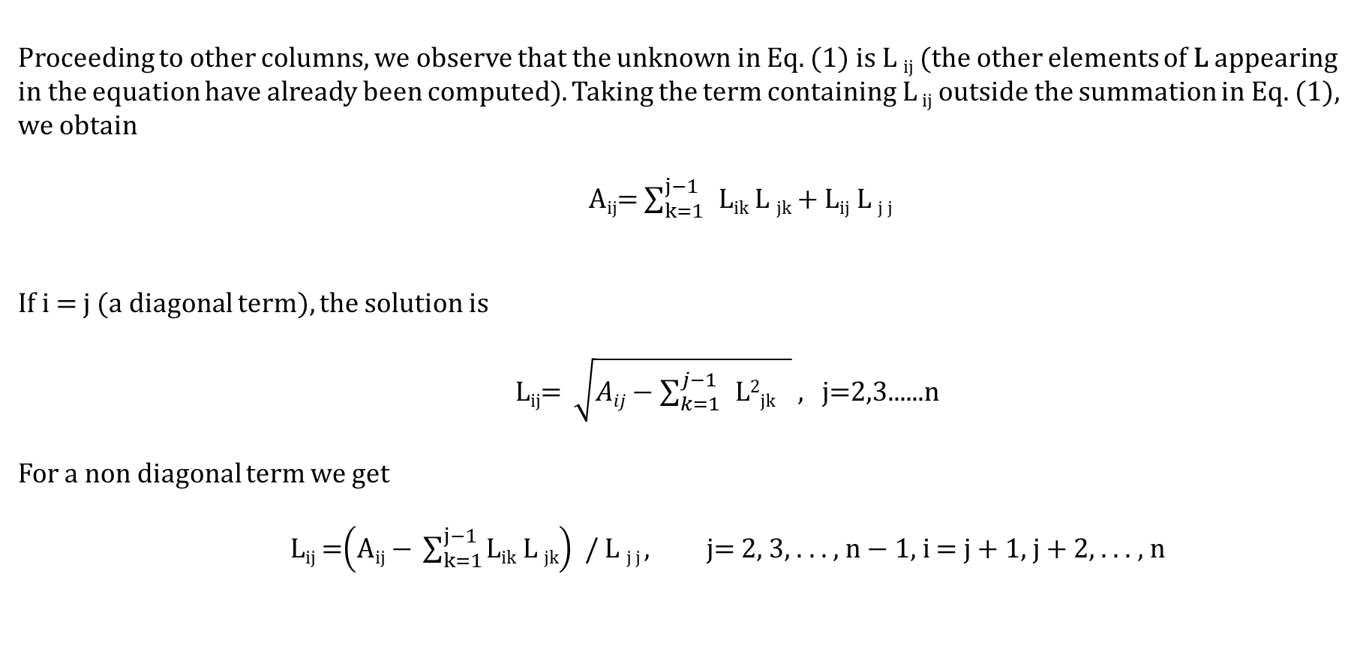
Proceeding to other columns, we observe that the unknown in Eq. (1) is L _{ij} (the other elements of L appearing in the equation have already been computed). Taking the term containing L _{ij} outside the summation in Eq. (1), we obtain
A_{ij}= $\sum_{k=1}^{j−1}{ }\text{L}\text{ik} \text{L} \text{jk}\text{ + }\text{Lij} \text{L} \text{j} \text{j}$
If i = j (a diagonal term), the solution is
L_{ij}= $\sqrt{Aij−\sum_{k=1}^{j−1}{ }\text{L}\text{2}\text{j}\text{k} }$ , j=2,3......n
For a non diagonal term we get
L_{ij} =$\left(\text{A}\text{ij}\text{ − }\sum_{k=1}^{j−1}{\text{L}\text{ik} \text{L} \text{jk}}\right)$ / L _{j j} , j= 2, 3, . . . , n − 1, i = j + 1, j + 2, . . . , n

Slide 12

Example: Compute Choleski’s decomposition of the matrix.
$$\left[\begin{matrix} 4 & −2 & 2 \\ −2 & 2 & −4 \\ 2 & −4 & 11\end{matrix}\right]$$
Solution:
L₁₁=$\sqrt{4}$ =2 L₂₂=$\sqrt{2−l221}$=$\sqrt{2−12}$=1
L₂₁=-2/L₁₁ =-2/2= -1 L₃₂=(-4-L₂₁L₃₁)/(L₂₂)= (-4-(-1)(1))/1 =-3
L₃₁=2/L₁₁ =2/2 = 1 L₃₃=$\sqrt{11−L231−L232}=\sqrt{11−\left(1\right)2−\left(−3\right)2}=1$
L=$\left[\begin{matrix} 2 & 0 & 0 \\ −1 & 1 & 0 \\ 1 & −3 & 1\end{matrix}\right]$
A=LL^{T} A= $\left[\begin{matrix} 2 & 0 & 0 \\ −1 & 1 & 0 \\ 1 & −3 & 1\end{matrix}\right].\left[\begin{matrix} 2 & −1 & 1 \\ 0 & 1 & −3 \\ 0 & 0 & 1\end{matrix}\right]$
A= $\left[\begin{matrix} 4 & −2 & 2 \\ −2 & 2 & −4 \\ 2 & −4 & 11\end{matrix}\right]$

